Slide 1
National Information Assurance (NIA) Policy

Slide 2

Current Scenario
It is a connected world!
More and More services are being provided online
Continuous evolving and powerful technology available to everybody at a cheap price
With every opportunity come Risk.
Your business is at RISK!

Slide 3
Emerging Risks
Changing Political Scenario
Volatile political situation in the region
Qatar’s prominent role in International Arena
Changing Economic Scenario
Country with highest per capita income
International Sporting Events
Hacktivism
Sophisticated Attack Vectors
Insider Threats
Changing Legislative landscape
Cyber Crime Law issued in 2014
Data Privacy and Protection Law issued in 2016
Proposed Critical Information Infrastructure Protection Law*

Slide 4
Real Incidents
2012: Main players in Oil & Gas industry in Qatar has been impacted by major destructive cyber attacks.
2013: Major attack targeting TLD “Top Level Domains” and interrupt huge e-commerce websites in Qatar
2014: Many DDOS attacks targeting Financial and Energy sectors in state of Qatar
2015: Major attacks involving Information Disclosure in CSOs
2016: Major Data leakage attacks in Financial sector and several organizations compromised through IT Supply Chain

Slide 5
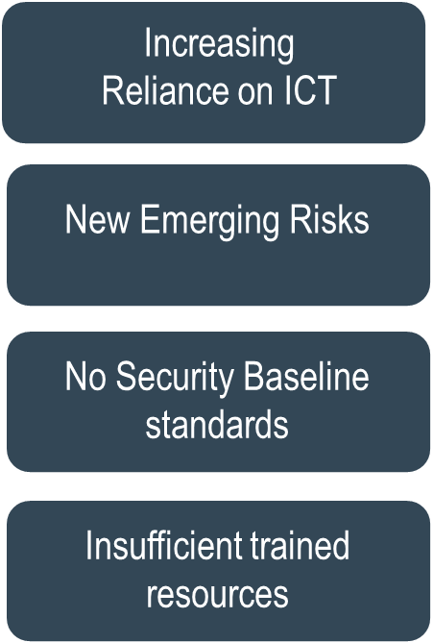
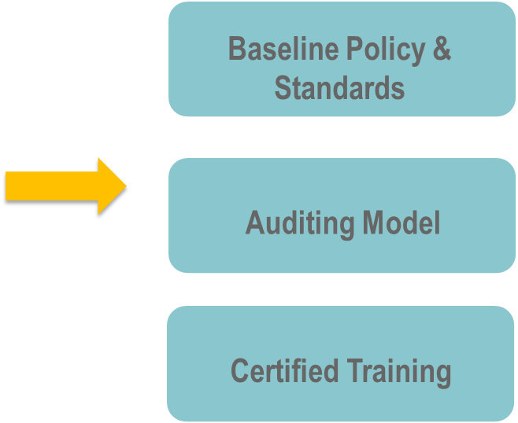
The need of Information Security Management System

Slide 6


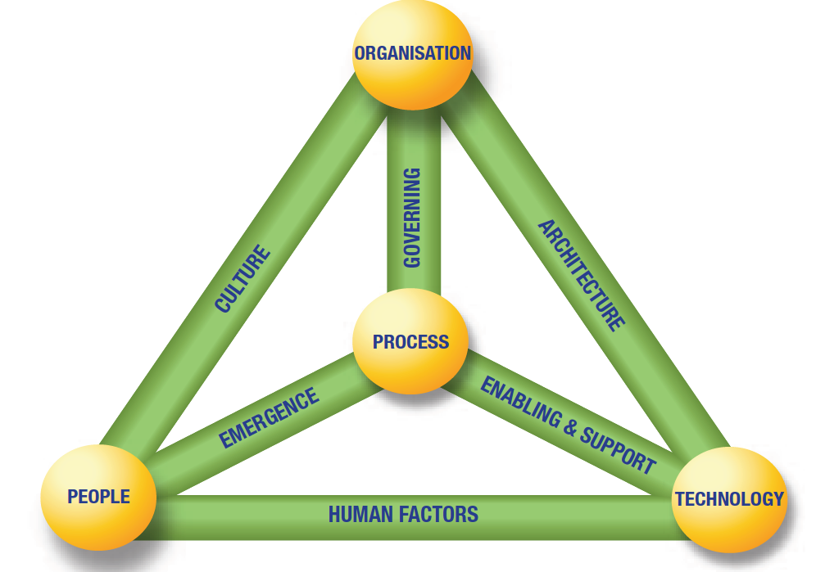

Challenges
Business Model of Information Security
Cultural Issues
Pre-set Mindset: Peaceful and secure environment
Lack of Awareness
Lack of Support
Lack of Resources

Slide 7

National Information Assurance Policy

Slide 8
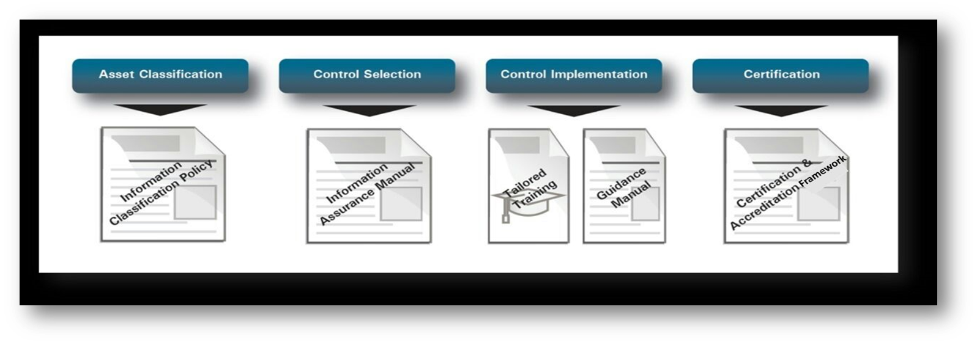
What is NIA Policy

Slide 9
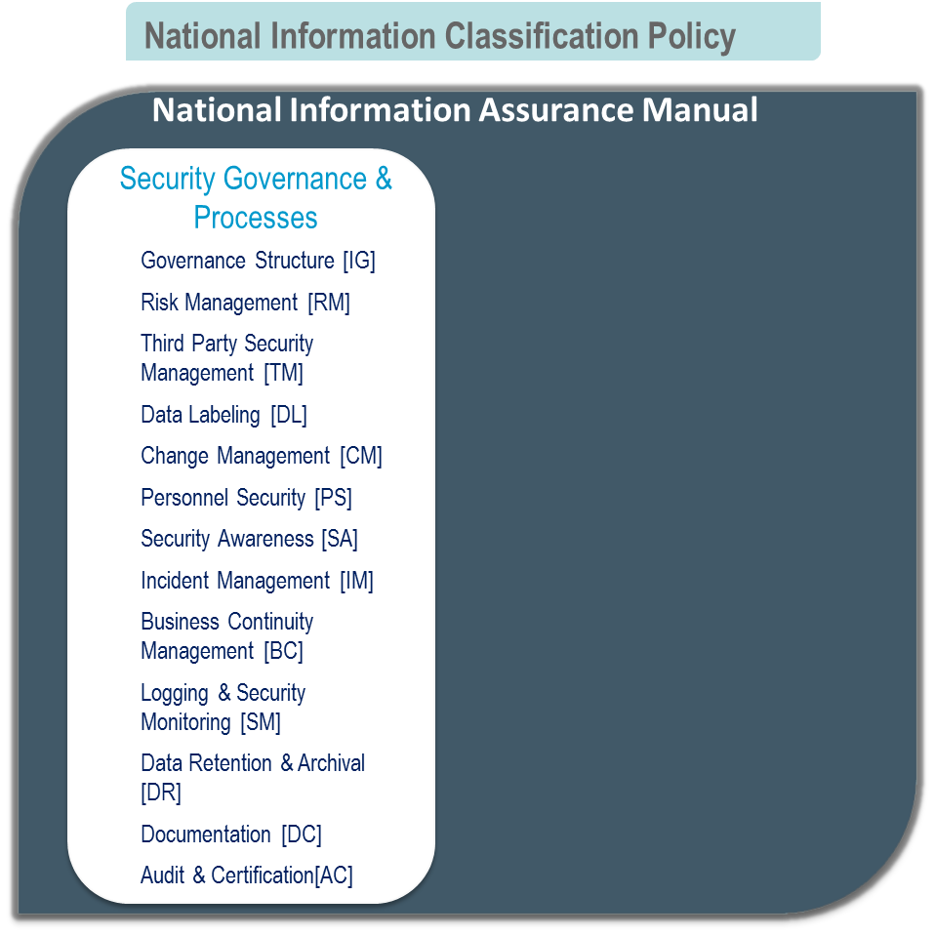
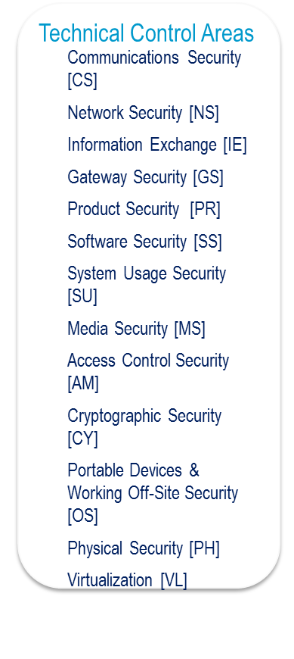
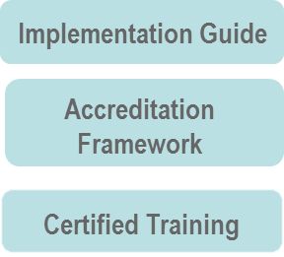
NIA Components

Slide 10
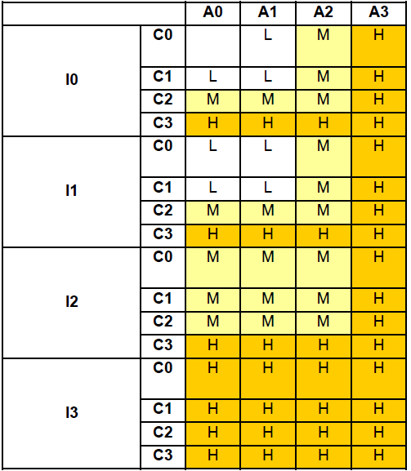
Assets Classification
Step 1:
Identify key processes and their owners in the organization.
Step 2: Identity process dependencies: information, applications, systems, networks, etc.
Step 3. Determine the security classification for each information asset using table
Step 4: Apply the necessary controls

Slide 11
NIA Policy is..
Approved and vetted by Council of Ministers, National Information Security Council.
Circular for Compliance issued by MoTC to Government Sector
Formulated from most common international standards/best practices
Allows straight forward path for certification against other standards e.g. ISO27001.
Adopted by leading organizations in government, finance and energy sectors.
Maps well with established standards such as ITIL, PCI DSS

Slide 12

Thank You
www.qcert.org

