Slide 1
IS Risk Management Framework Overview
QCERT
Notes:
0

Slide 2
Target Audience
This session is primarily intended for:
ü
Senior executives/ Decision Makers
ü
IS/ IT Security Managers and Auditors
ü
Governance Risk & Compliance Managers
CIO/ IT Managers
ü
ü
Business Managers (Process Owners)
ü
System and Information Owners

Slide 3
Table of Content
Need
Risk Management
IS Risk Management
Why manage IS Risk?
Benefits
How to manage IS Risk?
IS Risk Management Framework
Approach
Success Factors
Organizational Commitment
IS Risk Assessment plan

Slide 4



Need

Slide 5

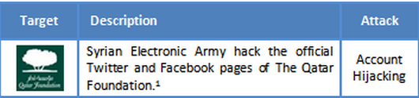

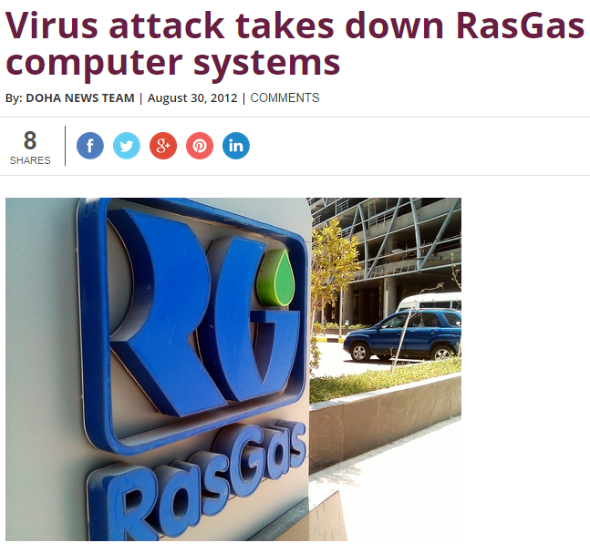


Need

Slide 6
Need
Chinese saying in IS Risk Management context
“If you know the enemy and know yourself, you need not fear the result of a hundred battles.
If you know yourself and not the enemy, for every victory gained you will suffer a defeat.
If you know neither the enemy nor yourself, you will succumb in every battle”
Attract threats
Biggest vulnerabilities
Information Security Risk Management (ISRM)
Organization’s “Crown Jewels”
Threshold for pain
Hacker interest
Government implication

Slide 7


Risk Management
What is Risk?
Risk is the potential of losing something of value
e.g. Information
What is Risk Management?
Systematic approach for managing risks within an organization

Slide 8
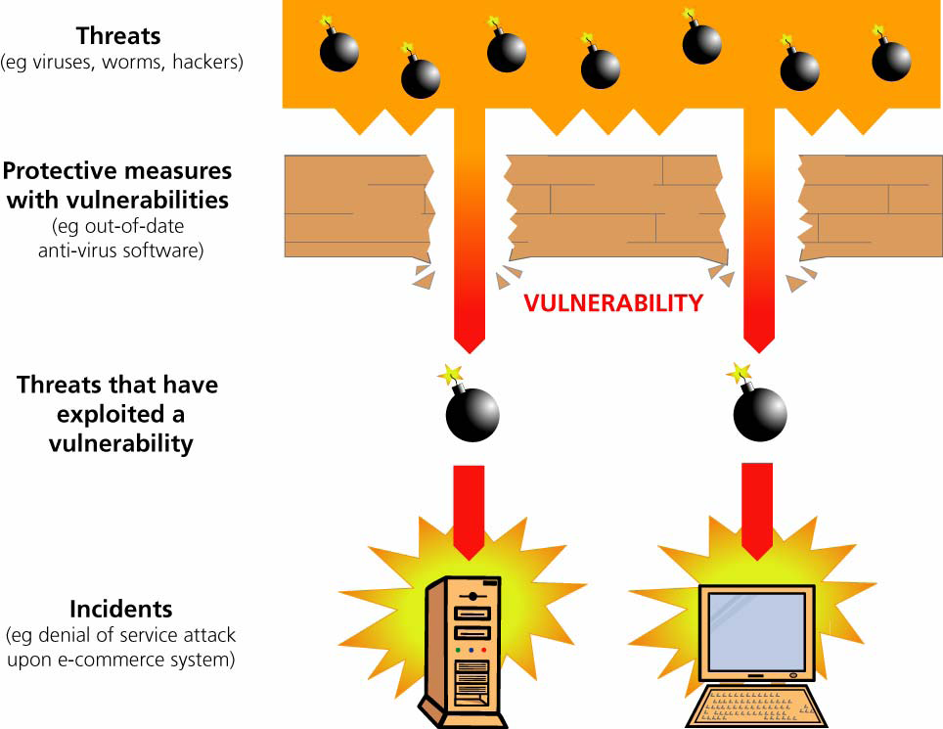
IS Risk Management
Information Security Risk
Likelihood of a threat source taking advantage of a vulnerability
What could go wrong
How likely is it?
What are the Impacts
Information Security Risk
Data Breach
Risk Level
Information Security Risk Management
Process of identifying, assessing information security risks and taking steps to reduce risk to an acceptable level
MANAGE RISK

Slide 9
Why manage IS Risk?
  Failure to meet
  Organizational goals
  & objectives
  Non-compliance to
  Qatar legal
  &
  regulatory requirements
  Face
  audit observations
  Unable to
  manage risks
  proactively
  Excess
  compliance cost
  Unable to
  manage outsourcing
  or
  third party risks
  Non-compliance to
  Global / regional
  compliance
  requirements

Slide 10
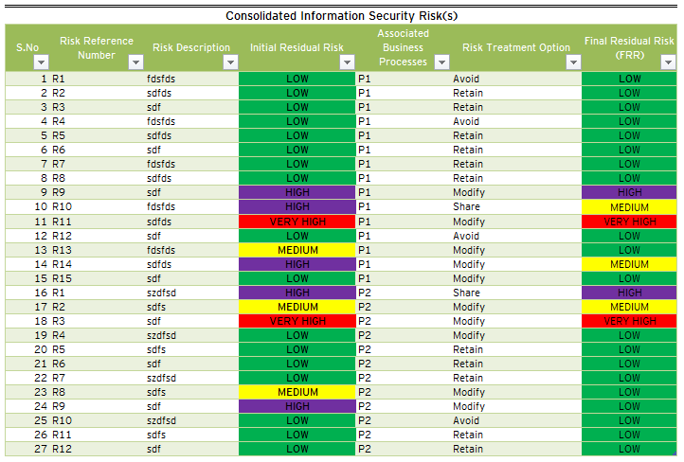
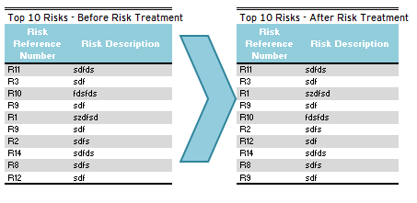
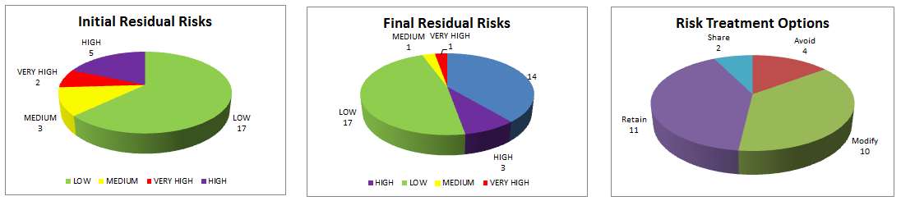
Benefits
Qatar National Cyber Security Strategy
National Information Assurance
Critical Information Infrastructure Protection (CIIP) Law
Cyber Crime Law
ISO 27005:2011 Standard

Slide 11
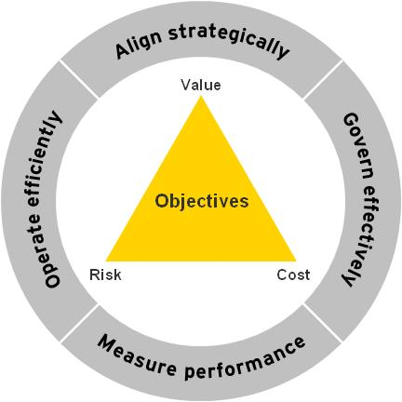
Benefits
Visibility to IS risks / opportunities;
Compliance with regulatory requirements;
Identify critical information assets;
Reduces frequency & magnitude of IS incidents;
Make more informed decisions;
Raise awareness about information security risks;
Increase the level of trust from customers and shareholders;
Drive business continuity planning; and
Demonstrate good corporate governance.
Achieve a Balance

Slide 12
How to manage IS Risk?
Apply effective controls
Take responsibility
Know the risks

Slide 13
ISRMF
Organizational Goals, Strategy, Governance and Policies
1.
Risk Identification
Threat & Vulnerability Management
Legal and Regulatory Requirements
5.
Risk
Monitoring
2.
Risk Assessment
Issues Management
IS Risk Governance
Enterprise Risk Management
Incident Management
4.
Risk Communication
3.
Risk
Treatment
Intelligence & research, incidents, previous RA and geo-political risk reports
Resource Template
IS Risk Program Management, Training & Awareness

Slide 14
Approach
ISRM process constitute following phases
Scope and Boundary
Policy & Procedure
Steering / Governance Committee
Roles and Responsibilities
ISRM Criteria(s)
Perform BIA
Identify
  Information Assets
  Vulnerabilities
  Threats
  Controls
  Inherent Risks
1.
Risk Identification
5.
Risk
Monitoring
2.
Risk Assessment
Monitor
  Risk Treatment
  Residual Risk
  New Risks
Identify change
IS Risk Governance
Assess
  Information Asset Value & Classification
  Vulnerability Factor
  Threat Likelihood
  Controls Effectiveness
  Cost of Control
  Initial Residual Risk
4.
Risk Communication
3.
Risk
Treatment
Develop Final ISRM Report
Communicate Residual Risks to Management
Obtain Management Approval
Conduct awareness sessions
Select Treatment Option
  Modify
  Share
  Avoid
  Retain
Treat Risks
Final Residual Risk

Slide 15
Success Factors
Key factors to implementing a successful security risk management program include:
Executive sponsorship
ü
Well-defined list of risk management stakeholders
ü
Organizational maturity in terms of risk management
ü
An atmosphere of open communication and teamwork
ü
Information security risk management team expertise
ü
14

Slide 16
Organizational Commitment
Effective management
Organization Commitment to ISRM
Continuous relationships
Active driving force
Systematic risk assessment
Specialist know-how
Clear rules
Independent review
Sound basic practices
‘on the ground’
Operational things ‘done right’
Disciplined handling of changes
Other risks controlled
Controlled access to system capabilities

Slide 17
For more information, visit www.motc.gov.qa
5/8/2018
16

