Slide 1
IS Risk Management Report (Template)
QCERT
Notes:
0

Slide 2
Table of Content
Objective
ISRM Methodology
ISRM Scope
Top 10 IS Risks
Initial & Final Residual Risks
Risk Treatment Options
Key IS Risks
List of IS Risks
Retained
Avoided
Modified
Shared

Slide 3
Objective
The primary objective of the Information Security Risk Management (ISRM) program is to identify, assess, treat, communicate / report and monitor information security risks. This report is intended to provide <Organization Name> management with a high level summary of the scope and approach of the ISRM program, the key risks identified and their business implications, and steps required to take to address the risks.

Slide 4
ISRM Methodology
ISRM process constitute following phases
Scope and Boundary
Policy & Procedure
Steering / Governance Committee
Roles and Responsibilities
ISRM Criteria(s)
Perform BIA
Identify
Information Assets
Vulnerabilities
Threats
Controls
Inherent Risks
1.
Risk Identification
5.
Risk
Monitoring
2.
Risk Assessment
Monitor
Risk Treatment
Residual Risk
New Risks
Identify change
IS Risk Governance
Assess
Information Asset Value & Classification
Vulnerability Factor
Threat Likelihood
Controls Effectiveness
Cost of Control
Initial Residual Risk
Illustrative
4. Risk Communication
3. Risk
Treatment
Develop Final ISRM Report
Communicate Residual Risks to Management
Obtain Management Approval
Conduct awareness sessions
Select Treatment Option
Modify
Share
Avoid
Retain
Treat Risks
Final Residual Risk

Slide 5
ISRM Scope
<The scope applies to all the information assets, technology infrastructure, information security practices and human resources involved in managing and supporting the IS environment>

Slide 6
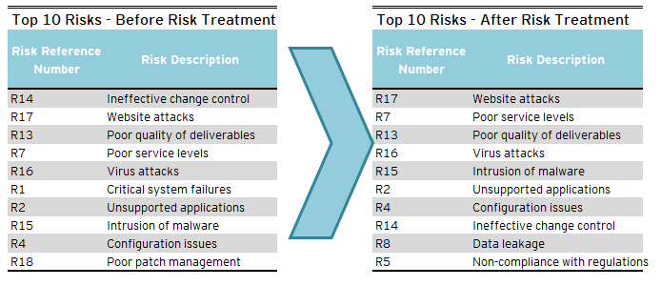
Top 10 Information Security Risks
Illustrative

Slide 7
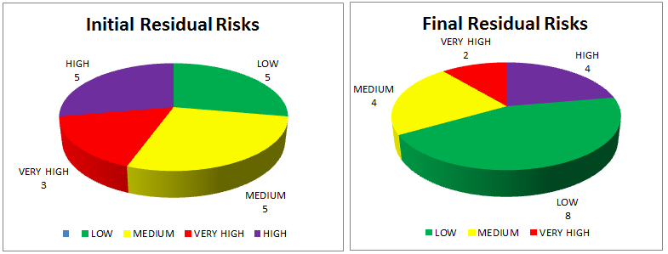
Initial & Final Residual Risks
Illustrative

Slide 8
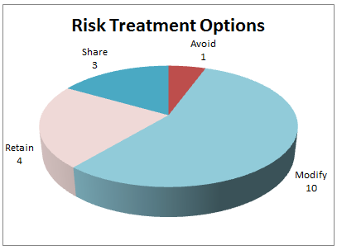
Risk Treatment Options
Illustrative

Slide 9
Key Information Security Risks
<Provide a brief description of the top 10 IS risks; It shall include risk description, initial and final residual risk rating, risk treatment option selected and risk owner>
<Information Security Risk> |  |  | Risk Reference #:
<Risk Description>
Initial Residual Risk |  | Final Residual Risk
Risk Treatment Option |  | Risk Owner

Slide 10
List of IS Risks - Retained
<Provide a brief description of the list of risks to be retained, avoided, modified and shared for management review and approval>
S. No | Risk Description | Risk Reference# | Final Residual Risk | Management Approval (Yes / No)

Slide 11
List of IS Risks - Avoided
<Provide a brief description of the list of risks to be retained, avoided, modified and shared for management review and approval>
S. No | Risk Description | Risk Reference# | Final Residual Risk | Management Approval (Yes / No)

Slide 12
List of IS Risks - Modified
<Provide a brief description of the list of risks to be retained, avoided, modified and shared for management review and approval>
S. No | Risk Description | Risk Reference# | Final Residual Risk | Management Approval (Yes / No)

Slide 13
List of IS Risks - Shared
<Provide a brief description of the list of risks to be retained, avoided, modified and shared for management review and approval>
S. No | Risk Description | Risk Reference# | Final Residual Risk | Management Approval (Yes / No)

Slide 14
For more information, visit www.motc.gov.qa
5/8/2018
13

